Slide 1

H2O WOW
A plant tracking application
Researcher: Daniel Cameron
Product Designer : Bailey Ivancic
Architect Designer : Hamza Mohammad
Marketing Director : Jon Stanley

Slide 2

What is H2O Wow?
Product Description Statement : A tablet application to assist in garden/plant care through monitoring soil moisture and nutrients. This is done through IOT device integration, manual input and weather tracking.
Aim to solve the problem of plant care that arises from the lack of free time
Primary audience is younger generation, age range 18 - 40
Integration with IOT (Internet of Things) devices and smart home systems in order to automate tracking and plant care

Slide 3
How did we focus on families in the UCD
Designed a selection of the personas and scenarios around the members of a family unit
Targeted families for the questionnaire (eg devices)
Time constraints meant this wasn’t possible for the user experience tests
Used material design with clear, large interactable areas to cater for all members of the family unit
Used familiar iconography with understandable meanings to ensure memorability and ease of use, not reliant on previous knowledge
Segmented functionality to decrease cognitive load on users
Grouping of common themes and elements for easier recall and decreased cognitive load for all ages
Simple interface with minimal technical details to not overwhelm users

Slide 4

How does it benefit families?
In today’s busy environment, it helps bring families together for a fun activity.
Encourages positive competitiveness using the social aspect of the app.
Reduces the chances of plants dying due to forgetfulness, problem exacerbated by children.
Notes:
*https://www.ncbi.nlm.nih.gov/pubmed/19568835

Slide 5

Collaborative design
Allowed for the use of powerful tools such as brainstorming
Variety of ideas from designers with different backgrounds
Took the best parts of each design
A minimum number is needed to run user experience designs, allowed for lots of useful data to iterate with.

Slide 6
H2O Wow First Draft

Slide 7
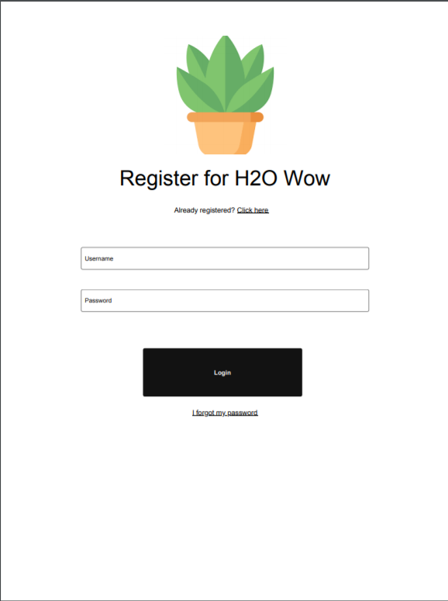
Register Page
The very first page the user will see if having not ever used the application
Standard screen to get started and make an account for H2O Wow
Notes:
Aesthetic/ minimal design: nothing to distract the user

Slide 8
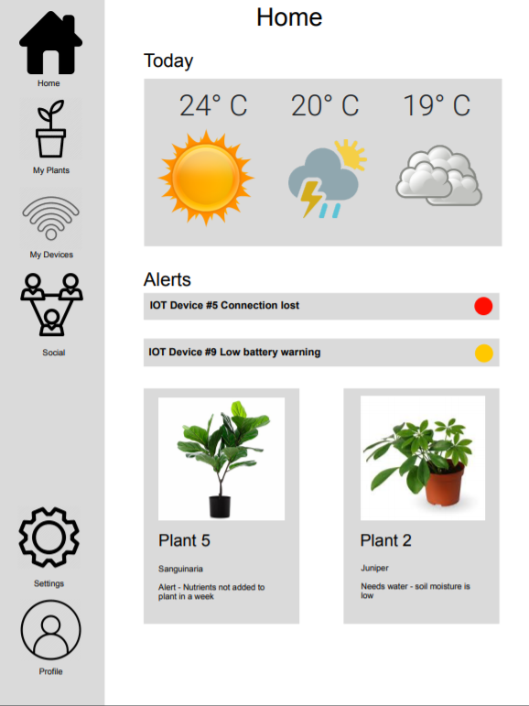
Home Page
This a starting point when users login into the application
Here an overview of the applications functionality can be viewed
Aesthetic weather aspect
Notification center containing
Alerts about users devices
Alerts or warnings about the status of plants
Links to other pages
Notes:
Notif ctr allows users multiple ways to see different parts of the app - Flexibility of use
Navbar follows established trends: flexibility of use

Slide 9
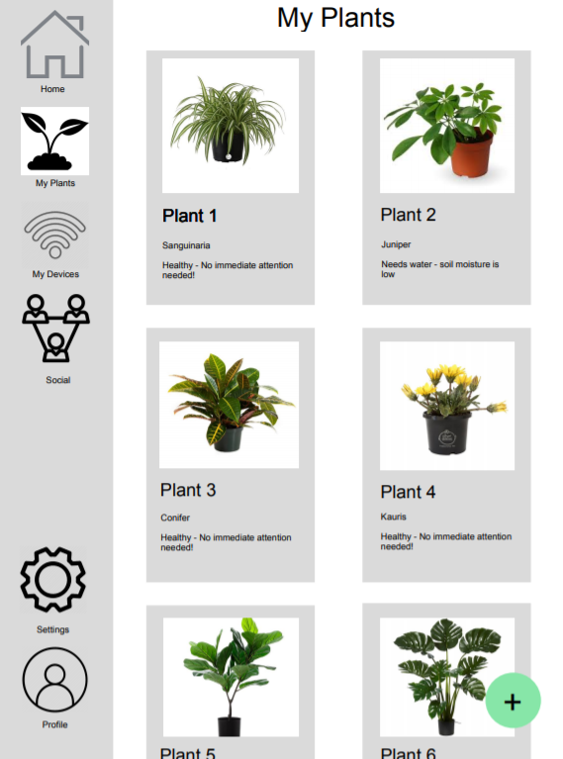
Plant Page
This page is one of the most important aspects of H2O Wow
Users are expected to spend most of their time here
This is where users will view information, changes, log changes, and monitor their plants and plant needs
A card based design was used to present plants to the user.
The plus button motif is carried throughout the app
Notes:
Card design and material plus: consistency and standards and minimalistic design
Not shown modal allows for user control and freedom, x and tap background to minimse modals

Slide 10
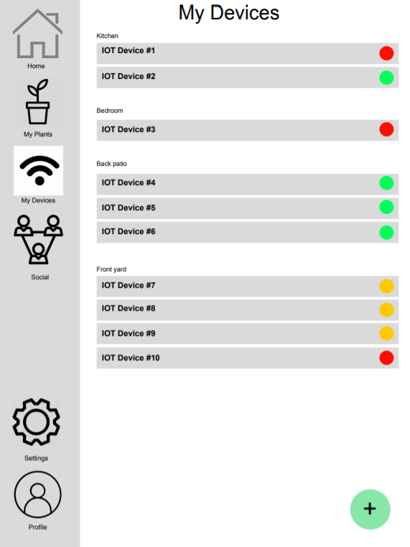
Device Page
The device page is placed directly below the plant page in the sidebar to apply affordance and logical neural connection
Users can view all of their IOT devices sorted in group by location in a list format
A tri-color scheme is applied to ensure cognitive load is minimised and associations of device status can be easily interpreted
The plus button appears again, maintaining consistency

Slide 11
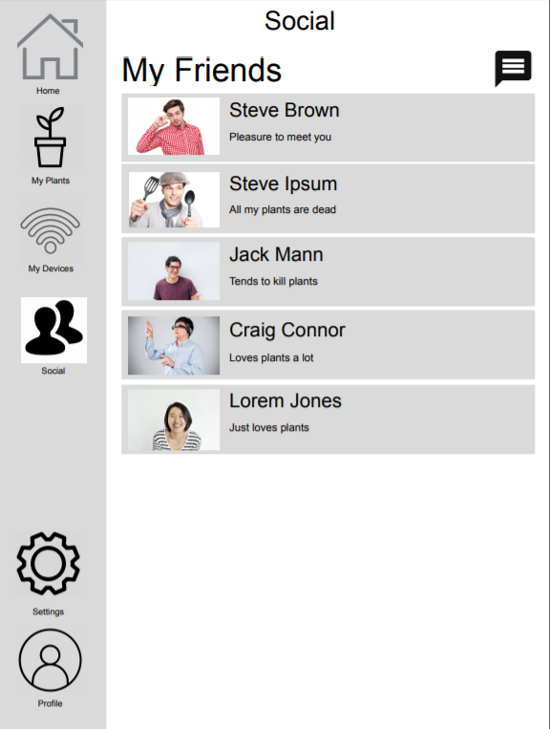
Social Page
Goes beyond the capabilities and usability as a standard plant tracking application
Allows users to view and add friends from which to contact and discuss plant care
Inspired by apps like instagram and strava
Provides a fun aspect to H2O Wow’s environment
Notes:
Strava is basically a social media platform for sporty people, upload your run/ride/ whatever and people can give you imaginary internet points

Slide 12
Improvements

Slide 13
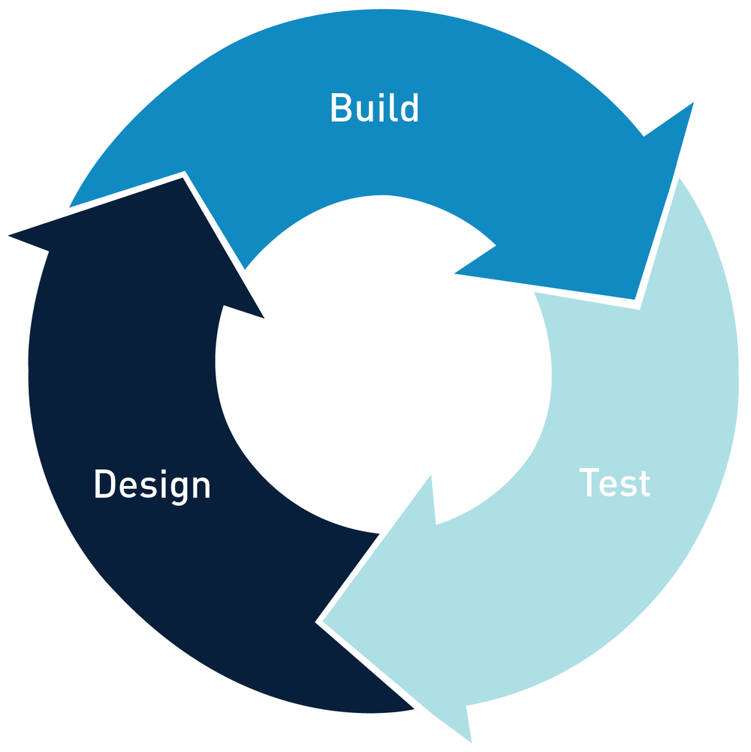
Iterative process
Relies heavily on feedback from users
Need to know how to get best feedback
Worked efficiently and successfully

Slide 14
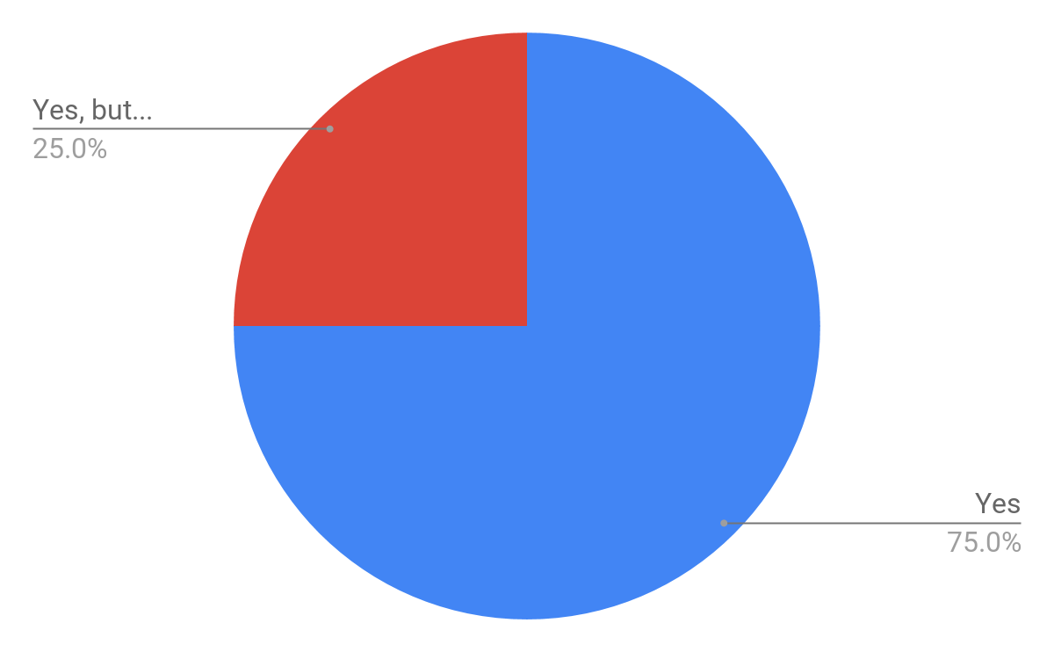
User experience tests results
Evidence from usability - most people commented that app was easy to use
80%+ people finished basic tasks in their time limits.
Positive feedback about plants page
Pictures
Nutrition monitoring
Adding was easy
Mixed responses regarding friends
Answers from users if they found the app easy to use:
Notes:
Yes
For the most part, yes
Yes
Relatively, yes
Yes
Yes
Yes, all in sidebar
Yes

Slide 15
Issues
Number | Description | Reason | Solution
Issue #1 | Users could not find registration button | Registration button appears too small | Make a larger registration button which is more visible (visibility)
Issue #2 | No password confirm on register | There is no password confirmation on register, users could accidentally mistype | Add in a second field to verify password creation (error prevention)
Issue #3 | Register flow is uncertain | The register button only says ‘login’ when it also creates the account | Change the ‘login’ button text on the register page to read ‘register’ (affordance)

Slide 16
Issues
Number | Description | Reason | Solution
Issue #4 | Register flow is uncertain | Once is the register screen it is not obvious how to return to login | Add large button which clearly states how to return to login screen (affordance)
Issue #5 | Users could not find search friends button | Search button icon not apparent at first glance | Remove need to enable search bar, have it always visible (visibility)
Issue #6 | Some icons confusing users | Inconsistency in icons across screens | Change icons to be more consistent (consistency)

Slide 17
Issues
Number | Description | Reason | Solution
Issue #7 | Inconsistent menu item naming | The inconsistencies in some menu items “My …” vs “...” | Remove ‘My’ from all menu items (consistency)
Issue #8 | ‘My profile’ confusing to some users | ‘My profile’ did not have much content in first prototype | Add content to ‘My profile’ and social if possible
Issue #9 | Viewing of IOT device issue inconsistent with modal approach | All other ‘more information’ style views in the app are presented through the use of modals, whilst the IOT device was a slide down | Turn the IOT device slide down element into a modal (consistency & affordance)

Slide 18
Issues
Number | Description | Reason | Solution
Issue #10 | Device icons are too bright | As the rest of the app has a muted color palette the use of full saturation for the status icons is jarring | Reduce the saturation on the status icons for devices (minimalist design)

Slide 19
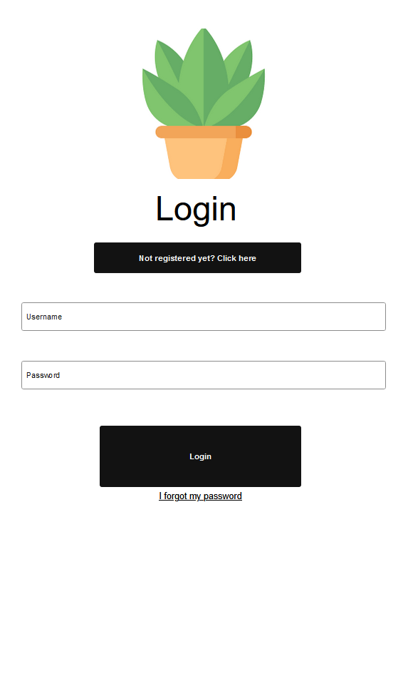
Login screen

Slide 20
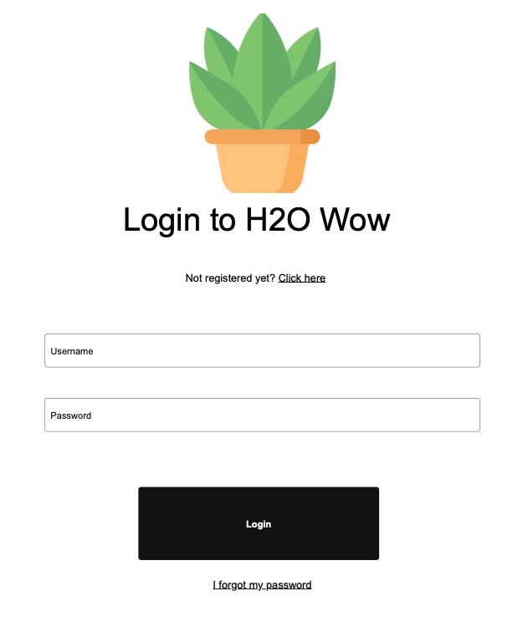
Issue #1: Login Screen
Issue: Users unsure where to click when prompted to make new account for the app
Text for registering is small and hard to read, goes against ingrained idea that small text is usually for forgotten passwords or other features

Slide 21
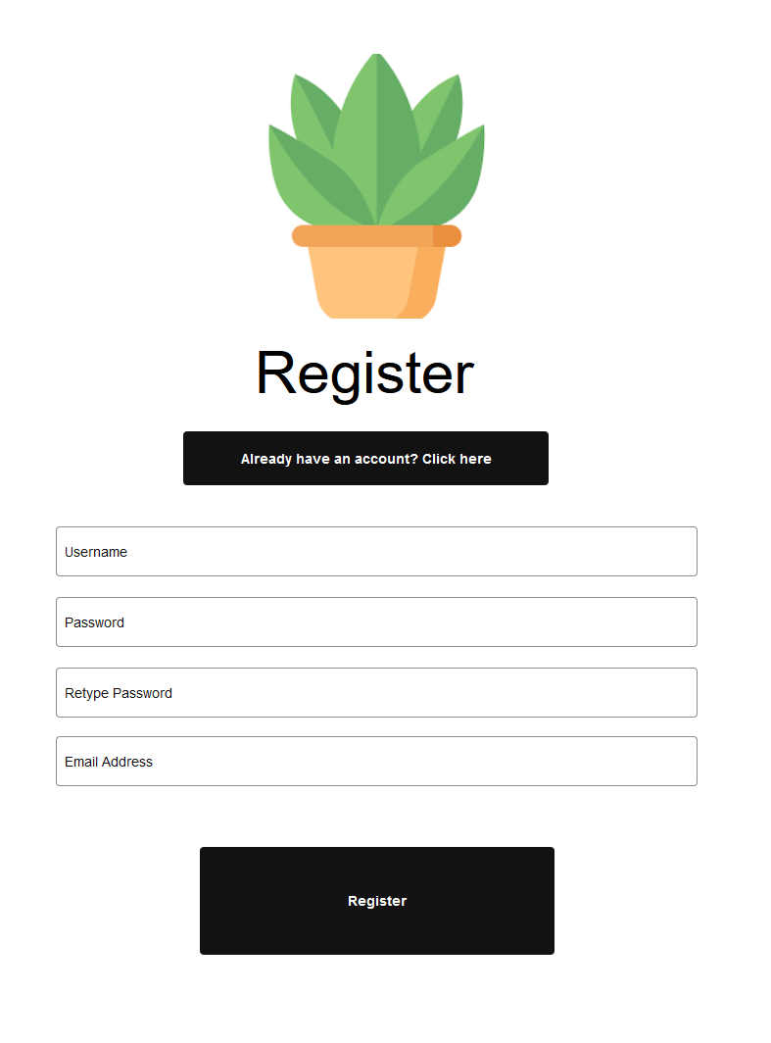
Register Screen

Slide 22
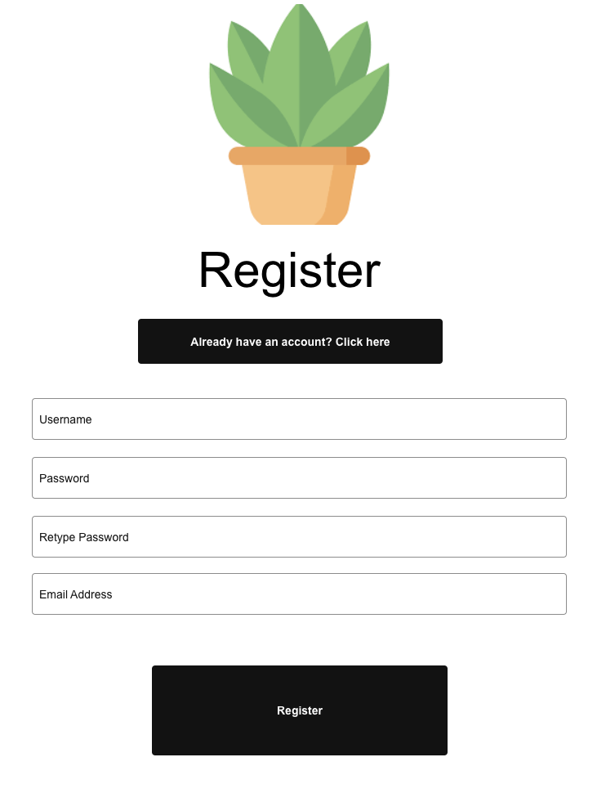
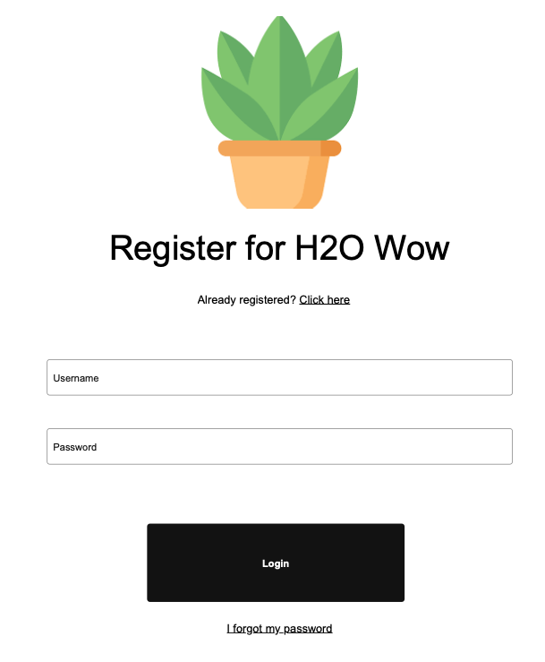
Issue #2, 3, 4: Register Screen
Title of page changed to “Register” and font size increased to make page more distinguishable
Prompts for existing accounts and new users changed to button to aid in function visibility
Button on bottom of register page changed to say “Register” instead of “Login”

Slide 23
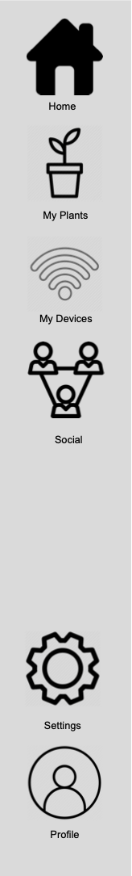
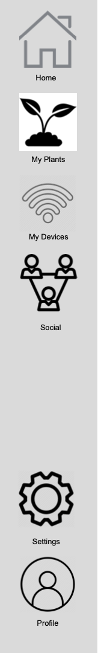
Issue #6, 7: Sidebar
A common criticism received was to do with the inconsistencies within the sidebar across the application:
Icons being different styles
Icons different when selected vs unselected
Selected background around the selected icon
Text used for labels, specifically “My devices/Plants” vs “Social”

Slide 24
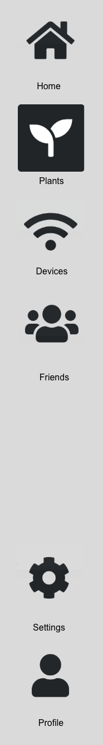
Issue #6, 7: solution
The following changes were made to the sidebar to address user critiques:
All icons sourced from https://fontawesome.com/ in order to keep a minimalist and uniform design across all the icons in the sidebar
Simpler, more minimal style adopted for the “selected” icon, using a negative icon (dark background and white icon) to more explicitly show the icon is selected
Adopted the use of a single word to label the icons, to aid in consistency

Slide 25
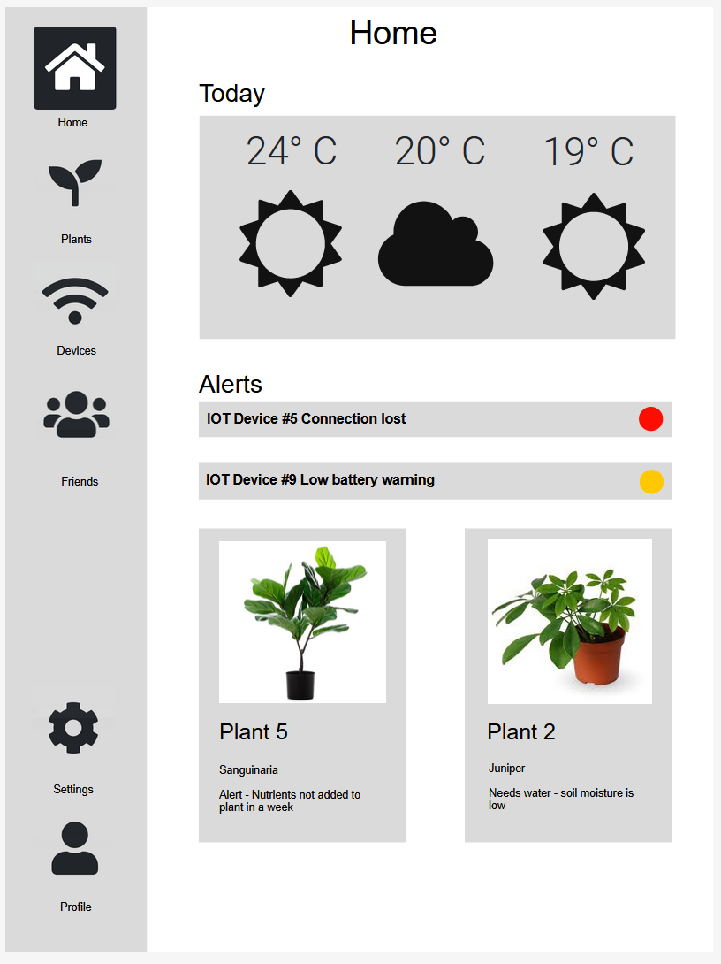
Home screen
Iconography for weather
was changed to font awesome
to ensure consistency throughout the app

Slide 26
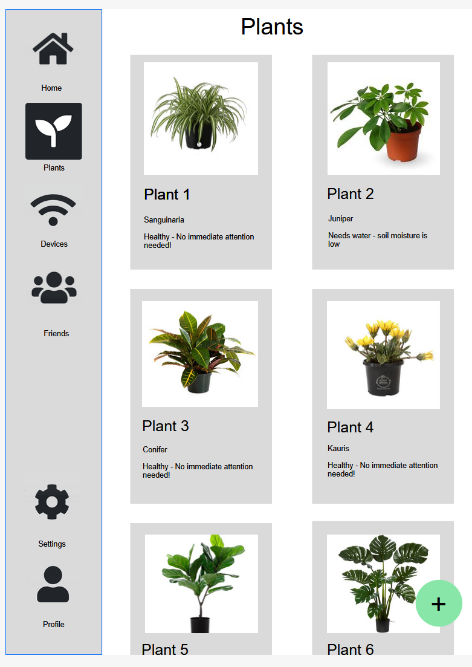
Plant screen

Slide 27
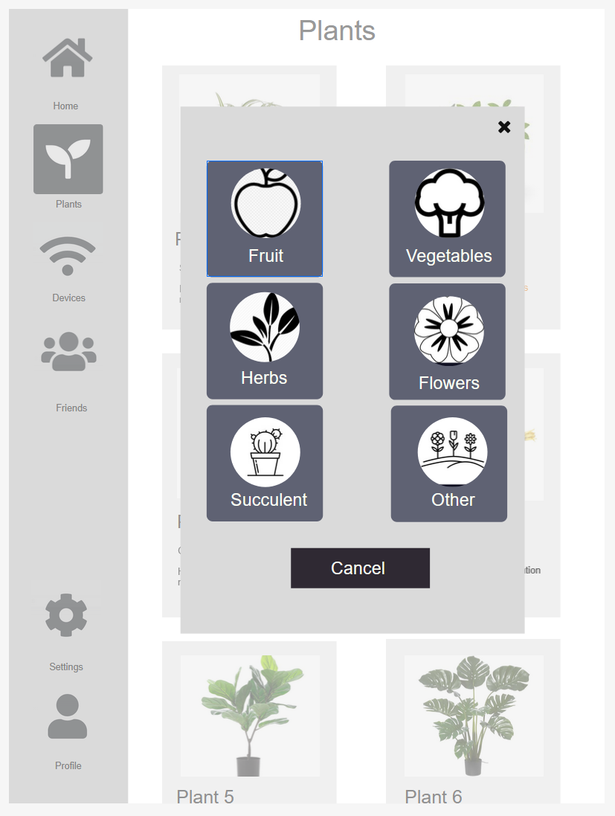
Add plant
Notes:
Note the use of modals, 1st of many

Slide 28
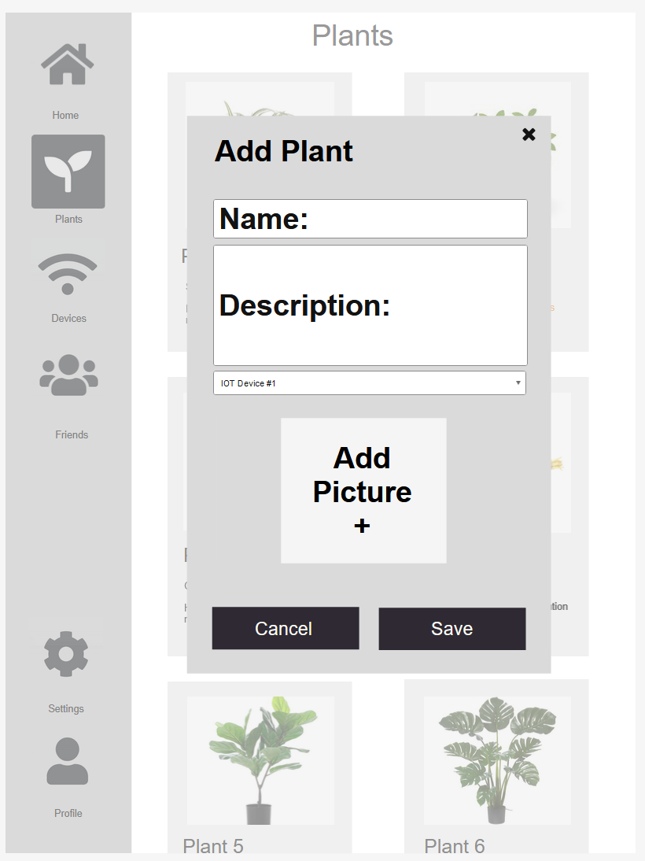
Finish adding plant

Slide 29
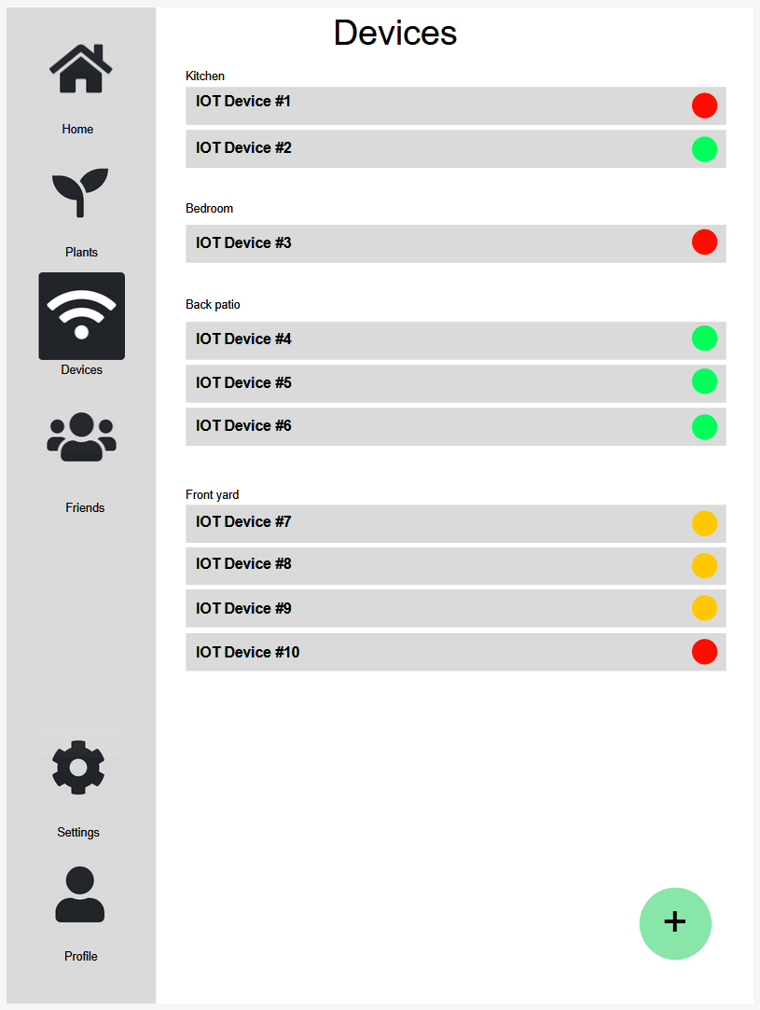
IOT sensor page

Slide 30
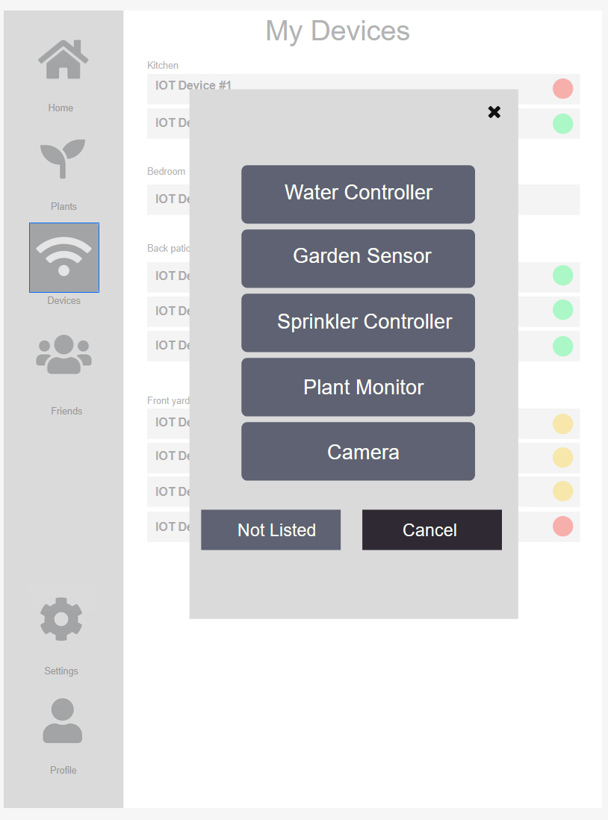
Add IOT sensor

Slide 31
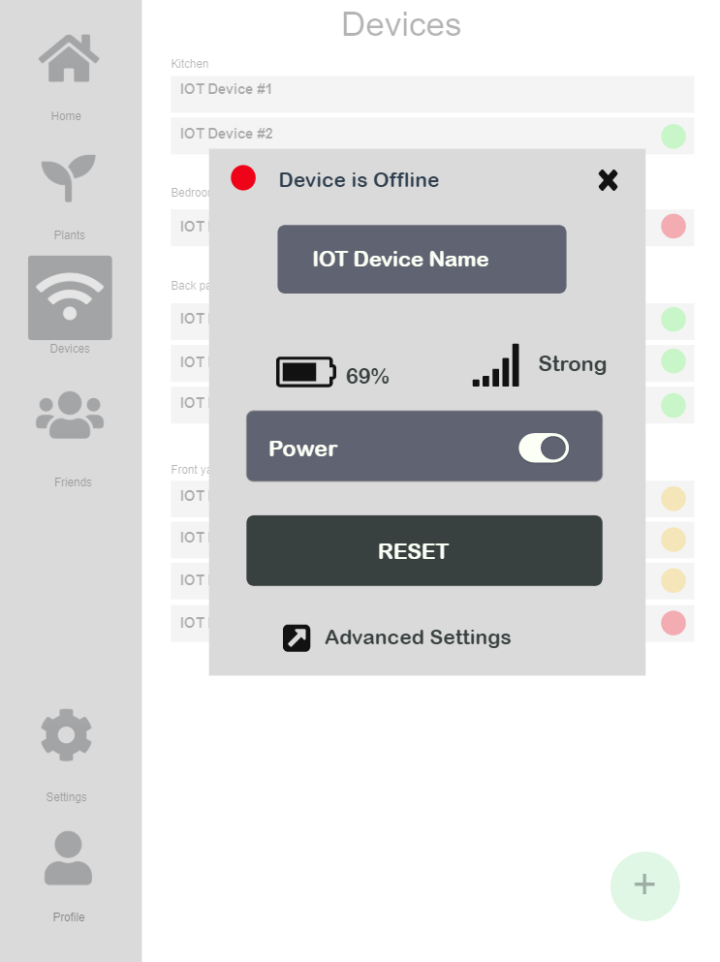
Device Details

Slide 32
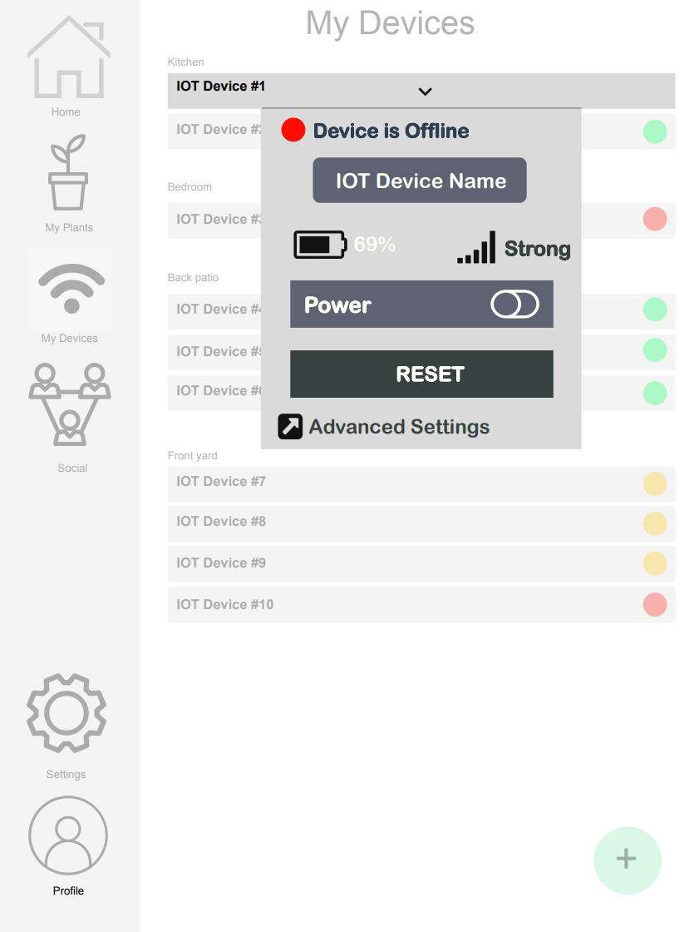
Issue #9: Device details
Changed device dropdown into a modal
This aids in consistency, since modals are used for all aspects of the app
Offers affordance since users showed good knowledge of modals and their operation

Slide 33
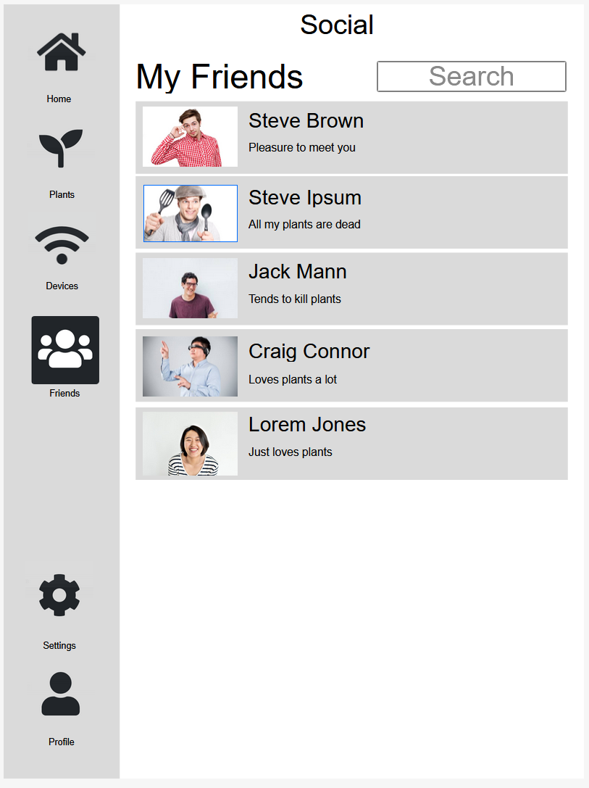
Friends

Slide 34
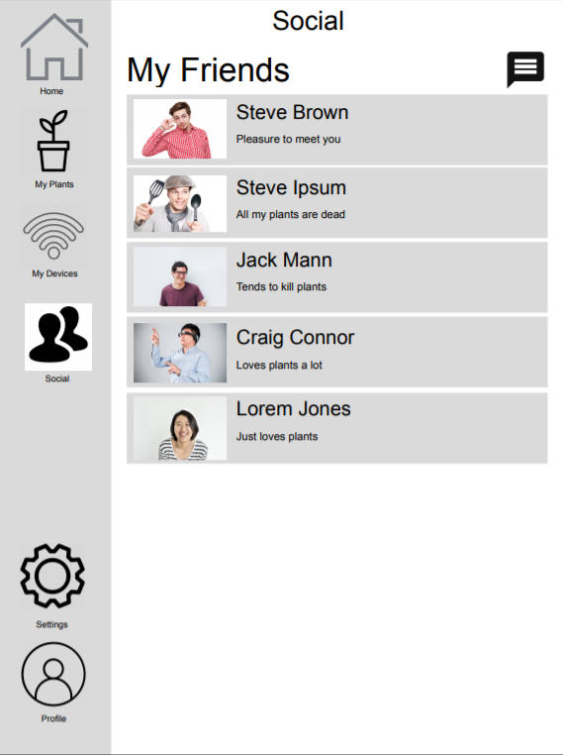
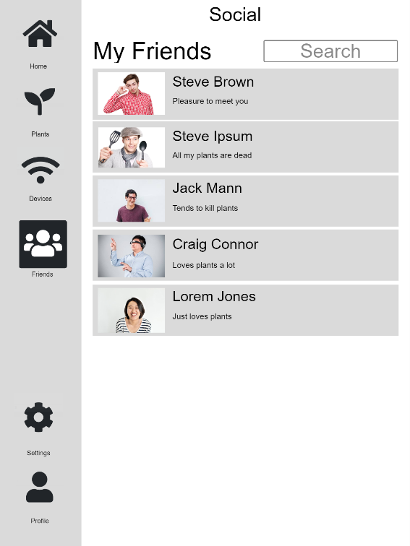
Issue #5: Social Page
In order to improve user experience the social page had to utilise common standards
The previous icon was changed into a search bar
Search bar is shared across all Social Pages
Notes:
Issue: Flow of the social page was not apparent to the user
Users came across an issue with “affordance” on the social profile page
Search button was not consistent with other pages
Icon used did not provide affordance to the search function
Issues also arise from consistency standards within other applications

Slide 35
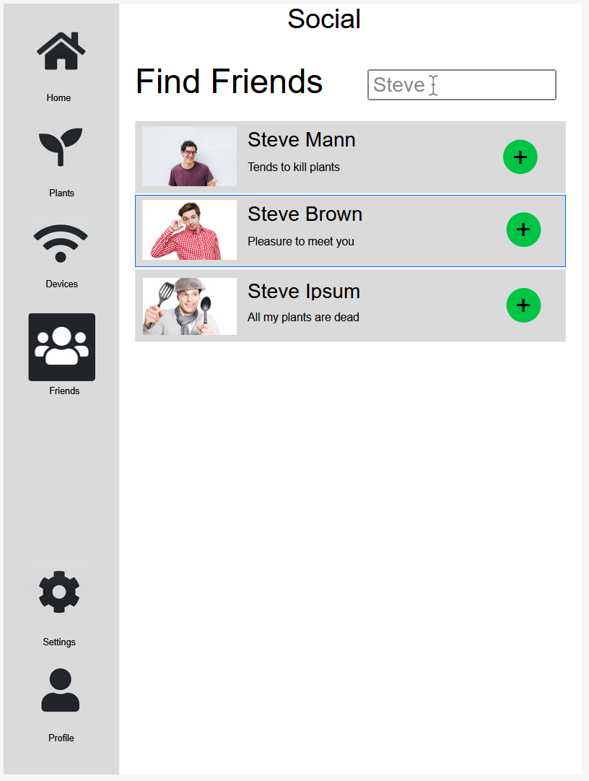
Find friends

Slide 36
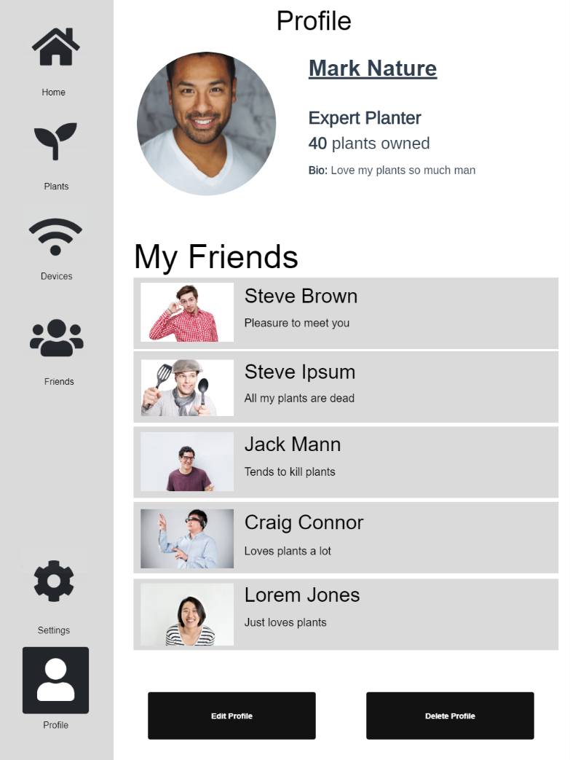
Profile
Notes:
Carry on the

